Slide 1
Name – Maddirala Sai Sudha Manaswini Student id - STU6371ec00bcd711668410368
Project - P2 - Power BI-Driven Exhaustive Analysis of Indian Agriculture Sector

Slide 2
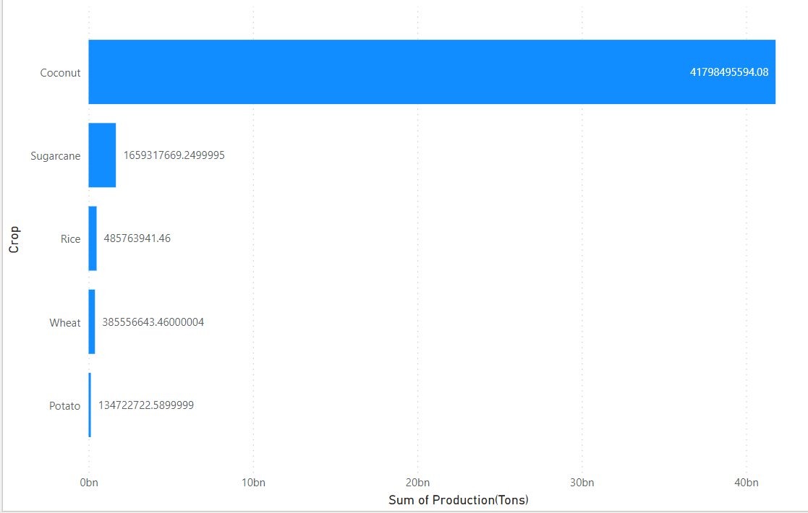
Top 5 Crops Production using Stacked Bar Chart

Slide 3
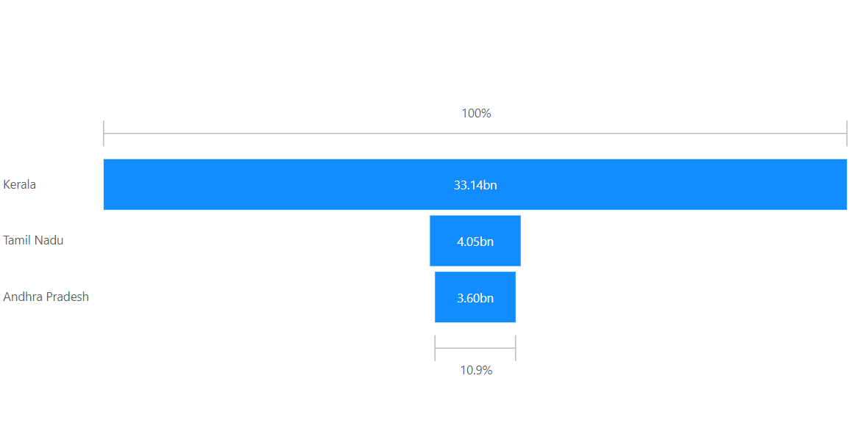
Top 3 States by Production Using Funnel Chart

Slide 4
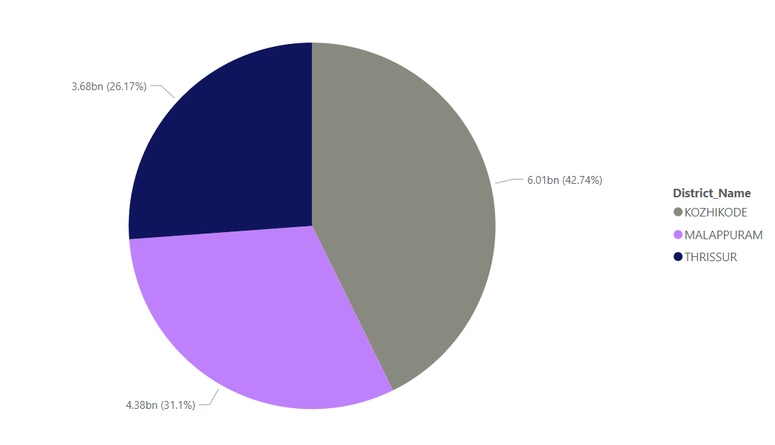
Top 3 District by Production Using Pie Chart

Slide 5
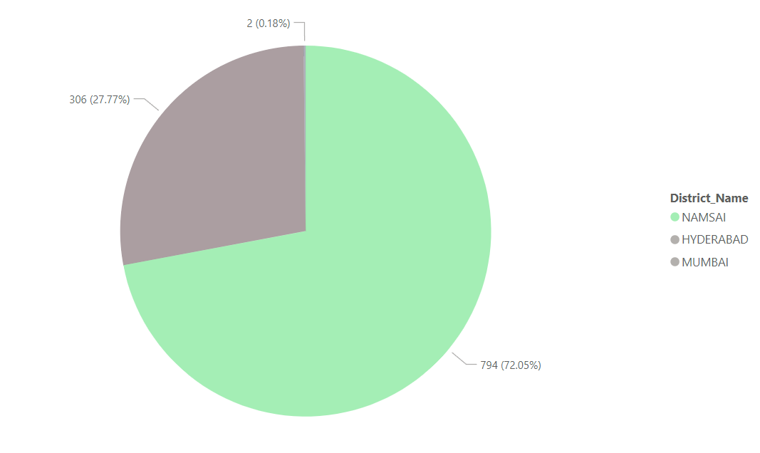
Bottom 3 District by Production Using Pie Chart

Slide 6
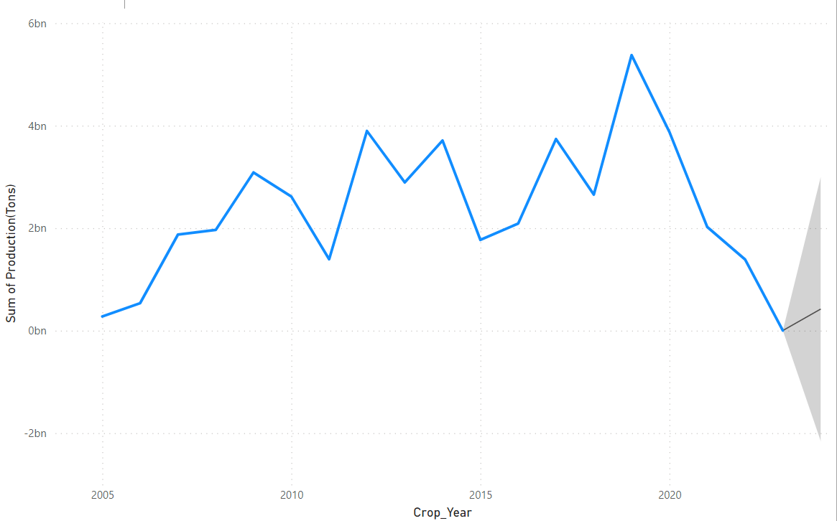
Prediction of Production by 1 year

Slide 7
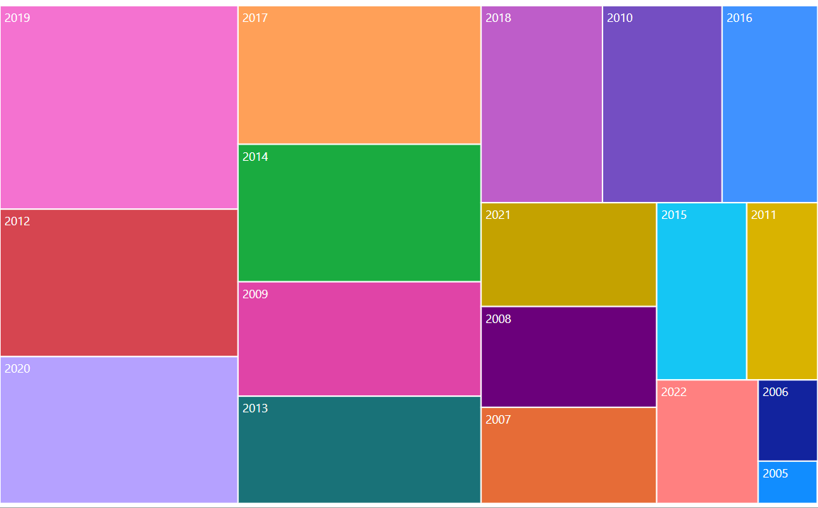
Production by each Crop Year

Slide 8
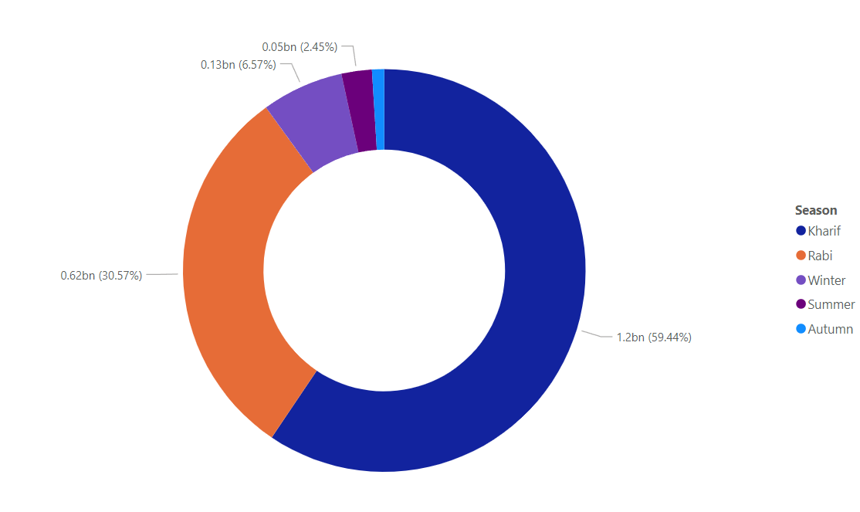
Production by Each Season

Slide 9
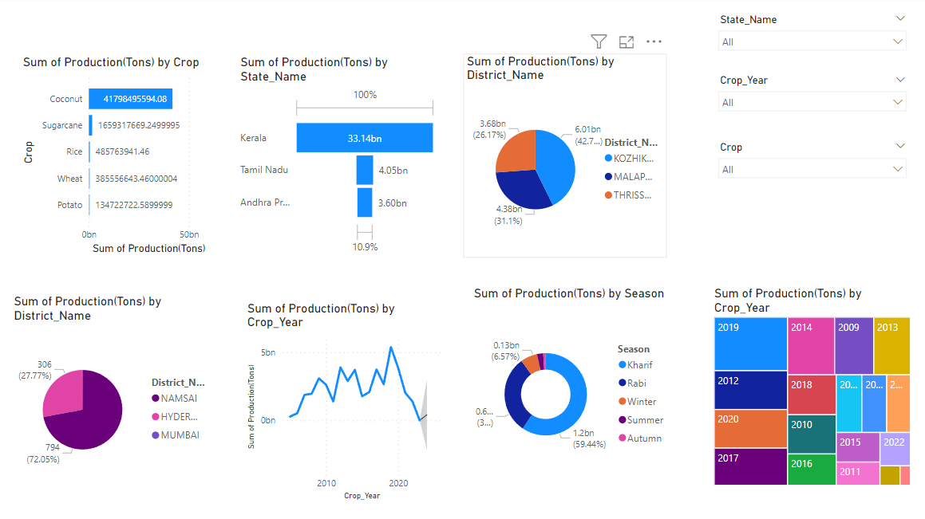
Production Analysis for Indian Crops

